Slide 1
From Modeling to Deployment of Active Objects - A ProActive backend for ABS
Ludovic Henrio, Justine Rochas
With the contribution of: Fabrice Huet, Zsolt Istvàn
Lamha, Jan 2015

Slide 2
About the SCALE team
Distributed applications are:
Difficult to program safely (correctness)
Difficult to program and run efficiently (efficient deployment running and synchronisation)
In the scale team we propose:
Languages: active object, asynchronous processes
Design support: Vercors – specification and verification of distributed components
Runtime support: a Java middleware, and VM placement algorithms
Application domains: cloud computing, service oriented computing …

Slide 3
Agenda
Active Object Programming models
Multi-active Objects: Principles
Scheduling in Multi-active Objects
A ProActive backend for ABS
Conclusion and Future Works

Slide 4
Active objects: generalities
Asynchronous method calls / requests
No race condition: each object manipulated by a single thread
α
β
f
Result
Result
Access foo
Access foo
foo = beta.bar(p)
…

Slide 5
ASP/ProActive Principles
Active and Passive objects
Asynchronous method calls ; request queue
With implicit transparent futures
Request invocation
α
β
result=beta.foo(b)
foo
Caromel, D., Henrio, L.: A Theory of Distributed Object. Springer-Verlag (2005)

Slide 6
ASP/ProActive Principles
Active and Passive objects
Asynchronous method calls ; request queue
With implicit transparent futures
Request invocation
α
β
f
beta.foo(b)
foo
result
result=beta.foo(b)

Slide 7
ASP/ProActive Principles
Active and Passive objects
Asynchronous method calls ; request queue
With implicit transparent futures
Wait-by-necessity
α
β
f
Result.getval()
…..
foo
WBN!!
Result.getval()

Slide 8
ASP/ProActive Principles
Active and Passive objects
Asynchronous method calls ; request queue
With implicit transparent futures
…
α
β
f
beta.foo(b)
foo
Result.getval()
Result.getval()

Slide 9
ASP/ProActive Principles
Active and Passive objects
Asynchronous method calls ; request queue
With implicit transparent futures
A beta = newActive (“A”, …);
V result = beta.foo(b);
…..
result.getval( );
Future sending
α
β
f
Result.getval()
beta.foo(b)
foo
Result.getval()
Result.getval()

Slide 10

First Class Futures
α
β
f
delta.snd(result)
δ

Slide 11
First Class Futures
α
β
Active objects are the unit of distribution and concurrency (one thread per AO / no data shared)
ProActive is a Java library ASP is a “calculus”
delta.snd(result)
δ

Slide 12
ASP: Summary and Results
An Asynchronous Object Calculus:
Structured asynchronous activities
Structured communications with futures
Data-driven synchronization
ASP ⇒ Confluence and Determinacy
Future updates can occur at any time
Execution characterized by the order of request senders
Determinacy of programs communicating over trees, …
2 - Confluence and Determinacy

Slide 13
Active Objects – Limitations
AO1
AO2
No data sharing – inefficient local parallelism
Parameters of method calls/returned values are passed by value (copied)
No data race-condition simpler programming + easy distribution
Risks of deadlocks, e.g. no re-entrant calls
Active object are single threaded
Re-entrance: Active object deadlocks by waiting on itself (except if first-class futures)
Solution: Modify the application logic, difficult to program
Notes:
No data sharing
* active object location transparent – must pass by value
* even if deploying several AO on a multi-core, still data copy overhead
No re-entrant calls
* deadlocking because of single-threaded nature
* must rewrite application (at least tail recursive)

Slide 14
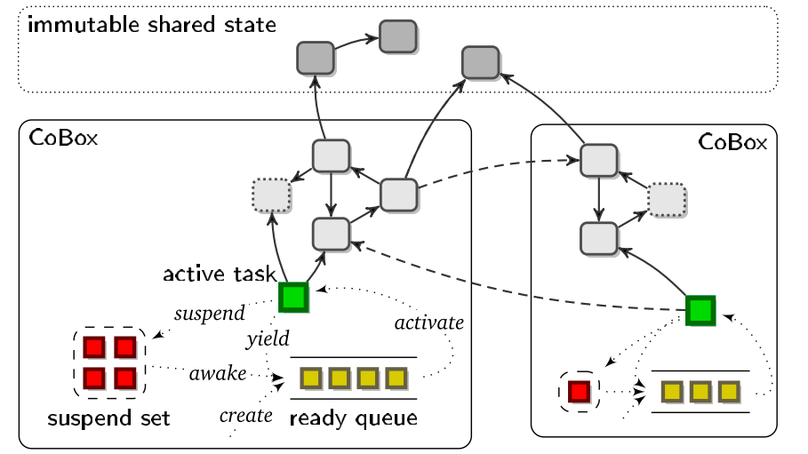
Another model: Cooperative multithreading
Creol, ABS, and Jcobox:
Active objects & futures
Cooperative multithreading
All requests served at the same time
But only one thread active at a time
Explicit release points in the code
can solve the re-entrance problem
More difficult to program: less transparency
Possible interleaving still has to be studied

Slide 15
ABS in more details
COG
COGs (set of objects)
Each object is active (can be invoked remotely)
Cooperative scheduling
Explicit syntax for asynchronous call and future access
obj
obj
COG
call()
A a = new cog A();
B b = new cog B();
b!foo(a);b!foo(a);
obj
obj
obj
obj
foo(A a) {
Fut<V> vFut = a!bar(p);
await vFut?;
V v = vFut.get;
}
foo(A a) {
Fut<V> vFut = a!bar(p);
await vFut?;
V v = vFut.get;
}
Notes:
----- Notes de la réunion (21/01/15 11:30) -----
texte sur é lignes

Slide 16
Active Object Models
Uniform Model
Non Uniform Model
Active objects only
Creol [4]
A lot of threads
Active & passive objects
ASP/ProActive
Complex semantic but scales
Object Group Model
All objects
are accessible
One thread
for many objects
JCoBox [5], ABS
A lot of global references to manage if not in shared-memory
Notes:
ABS will scale more than an uniform model, but only up to some point because of the quantity of references to manage

Slide 17
Explicit vs Transparent
Explicit asynchronous method invocation & future access
e.g.: Creol, ABS, JCobox
Transparent remote invocation and future access
e.g.: ASP/ProActive
Explicit asynchronous calls
Explicit futures
Transparent asynchonous calls
Transparent first class futures
object.method() // synchronous
object!method() // asynchronous
object.method() // synchronous or asynchronous
Fut<T> future = object!method();
T t = future.get; // blocks
T future = object.method();

Slide 18
Threading Models in Active Objects
Local Concurrency
Single-threaded
Cooperative
Multi-threaded
ASP and ProActive
Creol
JCoBox
ABS
MultiActive Objects (extended ProActive)
Neither ASP nor cooperative multithreading solve all the active object issues (multicore efficiency)
We propose an alternative AO model: more transparent but more parallel than ABS

Slide 19
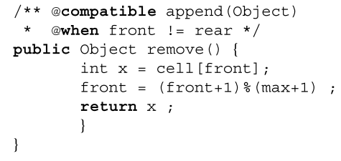
Some related work: JAC
Declarative parallelization in Java
Expressive (complex) set of annotations
“Reactive” objects
Simulating active objects is possible but not trivial
Our alternative view: new multithreaded AOs
A simple version of JAC for simple active objects à la ASP ➔ multi-active objects
efficient and easy to program

Slide 20
Agenda
Active Object Programming models
Multi-active Objects: Principles
Scheduling in Multi-active Objects
A ProActive backend for ABS
Conclusion and Future Works

Slide 21
Multi-active objects
A programming model that mixes local parallelism and distribution with high-level programming constructs
Execute several requests in parallel but in a controlled manner
join()
Provided add, add and monitor are compatible
add() {
…
}
add() {
…
… }
monitor(){…
… }
Note: monitor is compatible with join

Slide 22
Scheduling Requests
An « optimal » request policy that « maximizes parallelism »:
Schedule a new request as soon as possible (when it is compatible with all the served ones)
Serve it in parallel with the others
Serves
Either the first request
Or the second if it is compatible with the first one (and the served ones)
Or the third one …
Compatibility =
requests can execute at the same time
and can be re-ordered
compatible

Slide 23


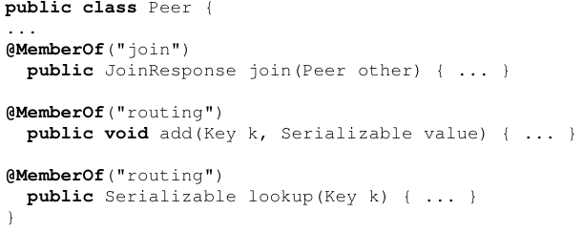
Declarative concurrency by annotating request methods
Groups
(Collection of related methods)
Rules
(Compatibility relationships between groups)
Memberships
(To which group each method belongs)
Notes:
Pairwise relation tedious if many methods.
Inheritance very problematic.

Slide 24

Dynamic compatibility
Compatibility may depend on object’s state or method parameters
join()
e.g. provided the parameters of add are different
add(int n) {
…
}
add(int n) {
…
… }
Returns true if requests compatible

Slide 25
Hypotheses and programming methodology
We trust the programmer: annotations supposed correct
static analysis or dynamic checks should be applied in the future
Without annotations, a multi-active object runs like an active object
If more parallelism is required:
Add annotations for non-conflicting methods
Declare dynamic compatibility
Protect some memory access (e.g. by locks) and add new annotations
Easy to program
Difficult to program
More parallelism ➔ More complex code / better performance

Slide 26
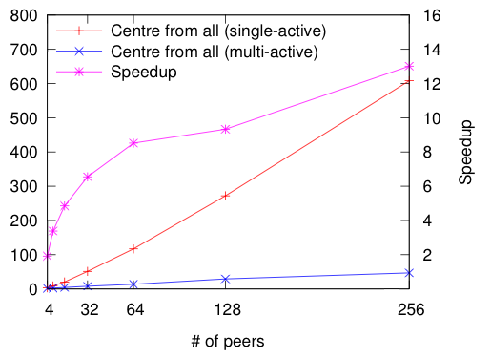
Experiment: CAN P2P network
Each peer is implemented by a (multi) active object and placed on a machine
Parallel and distributed
Parallel routing
Significant speedup due to parallelisation of communications, while controlling which communications are performed in parallel
With only a few annotations !

Slide 27
Agenda
Active Object Programming models
Multi-active Objects: Principles
Scheduling in Multi-active Objects
A ProActive backend for ABS
Conclusion and Future Works

Slide 28
Thread Limitation
Too many threads can be harmful:
memory consumption,
too much concurrency wrt number of cores
@DefineThreadConfig(threadPoolSize=4, hardLimit=false)
4 active threads
V v = o.bar();
v.foo();
start!
Still 4 active threads !
Notes:
Expliquer mieux hardlimit
This would not be possible with the hard limit set to true

Slide 29
Muti-active Objects Scheduling - Overview
Receive requests
Apply Compatibilities → Filter
Apply Priorities → Reorder
Apply Threading policies → Filter
Execute requests
Notes:
Enable high level implementation of scheduling pattern
Everything is based on groups
Each method of the AO (i.e. request) belong to a group
Compatibility between groups and inside a group
Possibly decided dynamically
Global thread limitation (soft or hard)
Upper and lower bound per group
Priorities among compatible requests to decide which to serve first

Slide 30
Priority Specification Mechanism
High priority
@DefinePriorities ({
@PriorityOrder({
@Set(groupNames = {"G1"}),
@Set(groupNames = {"G2"}),
@Set(groupNames = {"G5","G4"})
}),
@PriorityOrder({
@Set(groupNames = {"G3"}),
@Set(groupNames = {"G2"})
})
})
G1
dependency
G3
dependency
G2
G5
G4
Low priority
incoming
request R2
Priorities are automatically taken into account in the scheduling policy
R4 R3 R1
Notes:
Generated code
----- Notes de la réunion (21/01/15 11:30) -----
mettre workflow avant

Slide 31
Thread Limitation per Group
@Group(name=" routing ", minThreads=2, maxThreads=5)
routing
Threads never used
by the routing group
max
min
Threads never used
by other groups
Thread pool
Notes:
Limite + priorité = famine ➔ solution limite de thread par groupe

Slide 32
Summary of the programming model
Everything is based on groups of methods (requests)
Compatibility between groups and inside a group
Possibly decided dynamically
Global thread limitation (soft or hard)
Upper and lower bound per group
Priorities among compatible requests

Slide 33
Agenda
Active Object Programming models
Multi-active Objects: Principles
Scheduling in Multi-active Objects
A ProActive backend for ABS
Conclusion and Future Works

Slide 34
Motivation
ProActive – Multiactive Objects
Development and deployment of distributed applications ✔
OBJECTIVE
Provide distributed
deployment to ABS
using ProActive
ABS – Abstract Behavioral Spec. Language
Modeling of distributed applications ✔
Java Translator ✔
No support for distribution ✗
Notes:
table

Slide 35
Challenge
ABS
ASP/ProActive
Object Group Active Object model
Explicit asynchronous calls and futures
Cooperative threading model
Non Uniform Active Object Model
Transparent asynchronous calls and futures
Multi-threaded model

Slide 36
Active Object Creation in ProActive
on node1, active object o does:
T a = newActive(T.class, params…, node2)
// a: local reference to a proxy
node1
node2
active object o
object a
(proxy to ra)
active object ra
local reference
object
remote reference
active object
Notes:
ProActive: passive objects → non uniform language

Slide 37
Method calls in ProActive
on node1, active object a does:
P param1, param2 = … ;
T a = newActive(T.class, params…, node2)
V res = a.bar(param1, param2); // Same syntax as a local call
node1
node2
param1
param2
copy of
param1
copy of
param2
o
bar
a
ra
bar
Notes:
Remember two things : copy + transparent syntax

Slide 38
Translation Issues
Active Object Models
ABS ProActive
Object Group Model Non Uniform Model
Asynchronous Method Calls
Threading Models

Slide 39
Towards translation of ABS in ProActive
Select active objects
a COG = a ProActive active object
Entry point to the local memory space
Hierarchical indexing of objects
COG registry (RMI)
Global index via the network
Object registry (in a COG)
Local index via shared memory
Object URL | @COG1 | @COG2 | … | …
Object | cog1 | cog2 | … | …
Object ID | ID1 | ID2 | … | …
Object ref | o1 | o2 | … | …
Notes:
The first mechanism is encapsulated in ProActive. We created the second mechanism
----- Notes de la réunion (21/01/15 11:30) -----
scale in number of objects

Slide 40
Translation of a new cog statement
ABS code:
Server server = new cog Server()
Translated during compilation into:
Server server = new Server() (1)
COG cog = newActive(COG.class, {}, node2) (2)
cog.registerObject(server) (3)
node1
node2
main cog
(1)
server
(3)
remote
server
(2)
cog (proxy)
(2)
cog
Notes:
1 We create a server like a regular object nothing different from Java
Create a COG with newActive, and register the Server as passive object (deep copy of the server)
----- Notes de la réunion (21/01/15 11:30) -----
objets normaux

Slide 41
Translation Issues
Active Object Models
Asynchronous Method Calls
ABS ProActive
Explicit Transparent
Threading Models

Slide 42
Translation of an Asynchronous Method Call
ABS code:
server!start()
Translated during compilation into:
server.getCog().execute("start", {}, server.getID())
COG
node1
node2
server
Objects registry
main cog
remote
server
getCog
Object ID
Object ref
cog (proxy)
execute
cog
start
execute =
1-retrieve object with id
2-run by reflection
execute
Notes:
Why ? If we passed server1 in parameter, it would be the wrong one ! + it will be oprated on a copy of it on the other node !
Run will be called through reflection on the other node.
Here the id is copied but it doesn't matter
Once the execute method is scheduled, …

Slide 43
Asynchronous Method Call with Parameters
ABS code:
server!start(param1, param2)
Translated during compilation into:
server.getCog().execute("start", {param1, param2}, server1.getID())
node1
node2
main cog
server
param1
remote server
copy of
param1
getCog
start
param2
execute
copy of
param2
main cog
proxies
cog (proxy)
cog
execute
Notes:
Param1 & param2 are copied (RMI semantic), but they carry their COG with them so any call on those parameter will get back their original COG
Are also copied to be able to execute run properly. Why is that correct to copy?

Slide 44
Translation Issues
Active Object Models
Asynchronous Method Calls
Threading Models
ABS ProActive
Cooperative scheduling Multi-threading

Slide 45
Translation of an await statement
ABS code:
(1)
(1)
Fut<Bool> readyFut = server!start()
await readyFut?
(2)
(1)
(2)
Translated during compilation into:
(2)
(2)
PAFuture.getFutureValue(readyFut)
Blocks!
# of active threads = 0
start!
@DefineGroups({
@Group(name="scheduling", selfCompatible=true)
})
@DefineThreadConfig(threadPoolSize=1, hardLimit=false)
public class COG {
@MemberOf("scheduling")
public ABSType execute(…) {
}
}
# of active threads = 1
Notes:
As said before, the COG is an active object, more precisely a multiactive object
Another request can be served: this is exactly the behavior of the await statement
----- Notes de la réunion (13/06/2014 13:03) -----
picture instead of

Slide 46
Translation of a get statement
ABS code:
(1)
Fut<Bool> readyFut = server!run()
Bool ready = readyFut.get
(2)
Limit = 1 thread in total
Translated during compilation into:
(2)
this.getCOG().switchHardLimit(true);
Boolean ready = PAFuture.getFutureValue(readyFut);
this.getCOG().switchHardLimit(false);
Blocks all executions!
Limit = 1 active thread

Slide 47
Direct Modifications for Distribution
Serialization
Most classes implement now "Serializable"
Some fields have been made "transient"
Deployment
Node specification added in the ABS language
Server server = new cog "slaves" Server();
<GCMDeployment>
<hosts id="slaves" hostCapacity="1"/>
<sshGroup hostList="machine1 machine2" />
</GCMDeployment>
<GCMApplication>
<virtualNode id="slaves">
<nodeProvider capacity="4"/>
</virtualNode>
</GCMApplication>
XML files required to configure the application deployment
Notes:
Needed to go through the network
Limit the copies. We just need the id and the proxy of the cog all the rest is made transcient
Modified syntax
Characteristics of your clusters
Characteristics of your application in terms of deployment (Number of time a node can be requested in the application)
Provides an automatic mapping between the descriptors and their usage in the program → reuse this mechanism in ABS

Slide 48
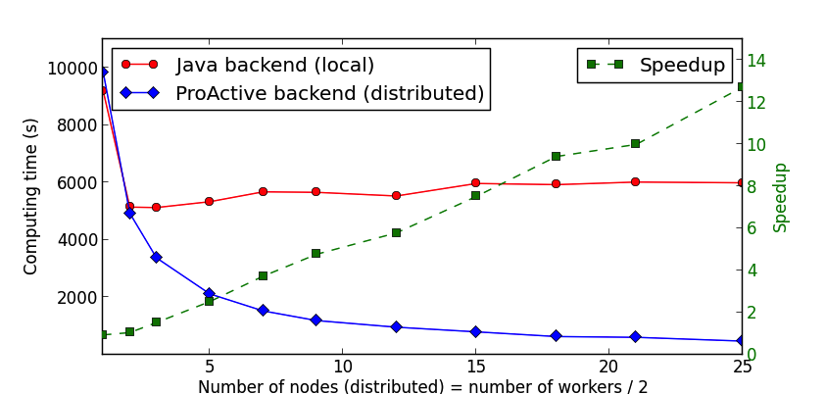
Experimental Evaluation
Constant speedup
Notes:
Expliquer usecase

Slide 49
Correctness of translation
Formalised an operational semantics for class-based multi-active objects
Formalised the translation ABS ➔ MAO
Proved that MAO simulates any ABS semantics and that MAO reductions correspond to a possible ABS execution (on most meaningful cases)
Restrictions:
Causally ordered communications; in ASP, request sending = rendez-vous
Requests served in FIFO order in ASP (also in Java backend)

Slide 50
Conclusion – A Fully Working Tool
Translation of await on conditions
Automated compilation & deployment of ABS programs
Significant speedup from local programs
Partial proof of correctness
await a == True && b == False?;
@Group(name="waiting", selfCompatible=true, minThreads=50, maxThreads=50)

Slide 51
Agenda
Active Object Programming models
Multi-active Objects: Principles
Scheduling in Multi-active Objects
A ProActive backend for ABS
Conclusion and Future Works

Slide 52
Conclusion (1/2): a new programming model
Active object model
Easy to program
Support for distribution
Local concurrency and efficiency on multi-cores
Transparent multi-threading
Simple annotations
A programming model for locally concurrent and globally distributed objects

Slide 53
Conclusion (2/2): Results and Status
Implemented multi-active objects above ProActive
Case studies, benchmarks: NAS, CAN, GCM components, ABS backend
Specified SOS semantics and proved
« maximal parallelism »
Correctness of ABS translation
Next steps:
Prove stronger properties, mechanised formalisation
Find deadlocks using behavioural types (ongoing PhD)
Design a recovery protocol for MAO
Provide a debugger for MAO (forthcoming internship)

Slide 54
Questions?
Related publications:
Multi-threaded Active Objects. Ludovic Henrio, Fabrice Huet, and Zsolt István - In COORDINATION 2013.
Declarative Scheduling for Active Objects paper. Ludovic Henrio and Justine Rochas - SAC 2014.

